Slide 1
BellaBeat Case Study
Fitness Trends
Tejaswi/March 20th, 2023

Slide 2
Business Task.
Trends.
Assumptions.
Conclusion.
Agenda

Slide 3
Bussiness Task
Gain insights into any trends in the use of non-Bellabeat smart devices utilising publicly available data.
If any trends are noted, the team is to look at how to apply these trends and advise on how it could apply to Bellabeat customers in order to influence future marketing strategies.
These findings and a high-level recommendation are then to be reported to the Bellabeat Executive Team.

Slide 4
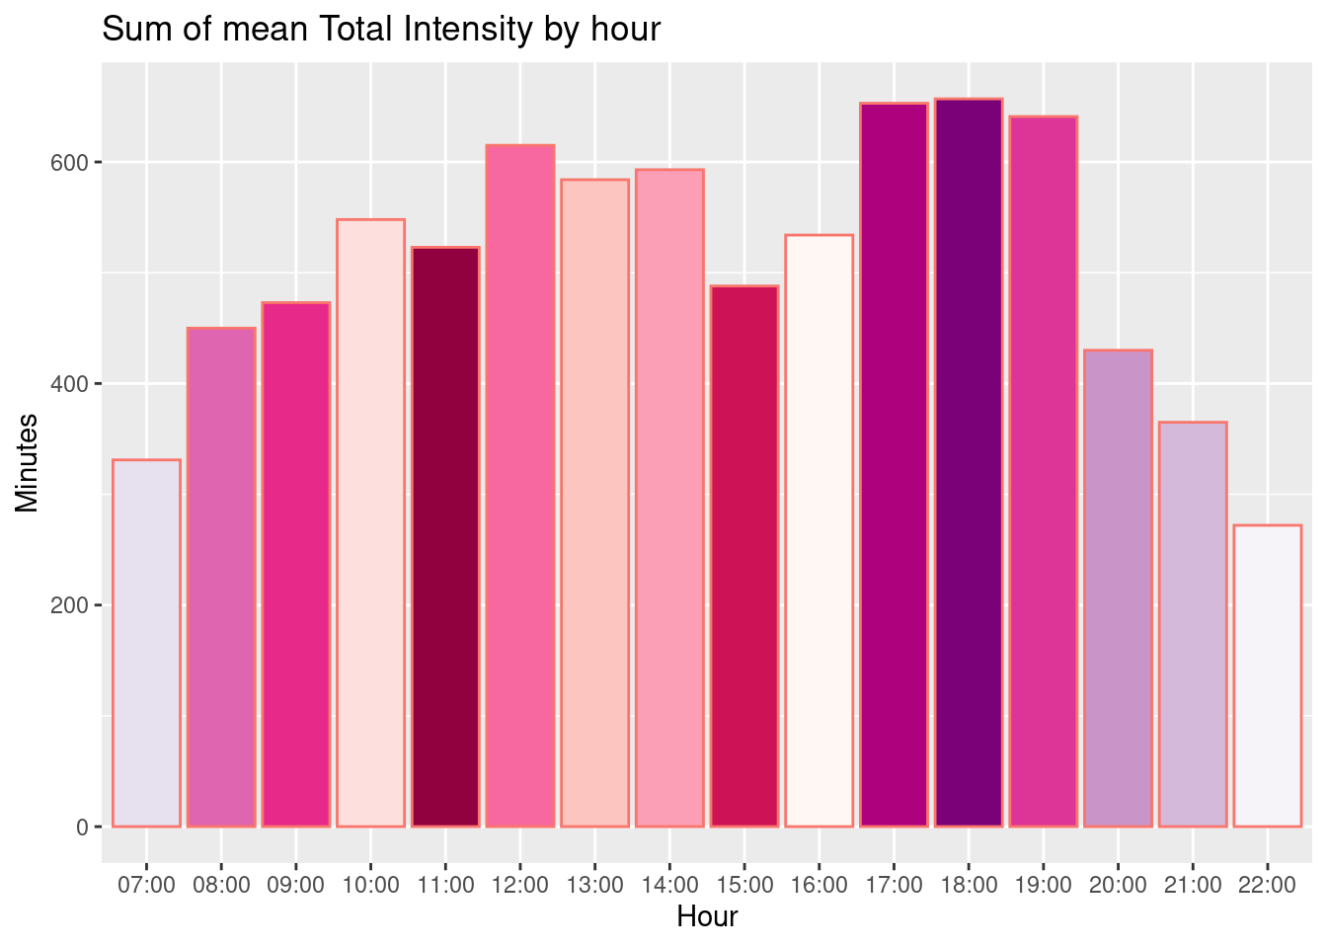
Mean Intensity by hour in a day
The most active hours are the 17:00 to 19:00 portion and 12:00.
The most inactive hours are lunch time or after lunch i.e., 15:00 to 16:00
Most of the people are active only in the evening, not in the morning.
Recommendation :
Set alarm and notify them to be active.
Recommend morning exercises and yoga.
Recommend short workouts for lunchtimes and how to keep active at work.

Slide 5
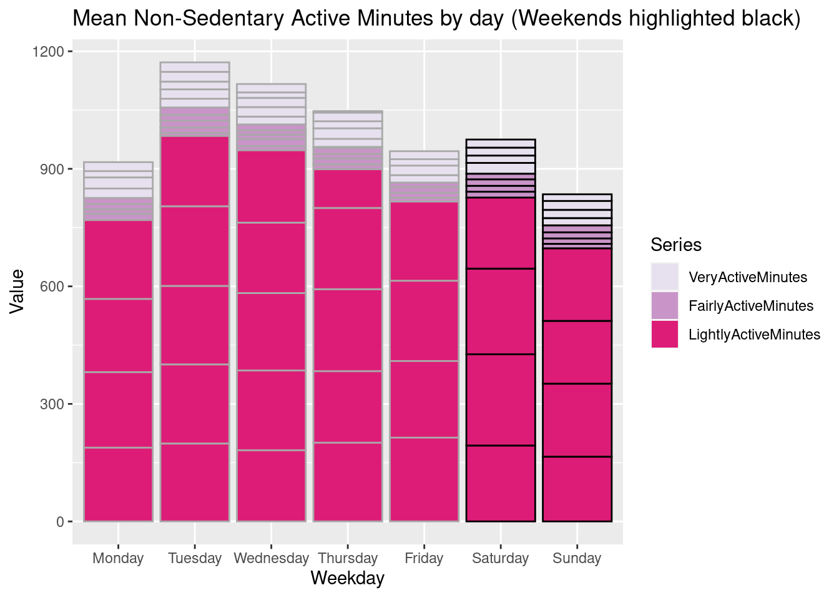
Active Days in week
Participants were most active on a Tuesday, but least active on a Sunday.
Recommendation :
Although it’s a day for rest, try and get users moving on a Sunday (or even remind them to rest!).
Congratulate them when they do hit their goals.

Slide 6
Time Spent in bed without sleeping
On average, participants were in bed for almost 40 minutes more than they slept.
This could point to difficulty in falling asleep or staying asleep.
Recommendation :
Distribute advice on good sleeping routines, possibly partner with meditation apps to help (Headspace, Calm…).
Min. minutes | 1st Qu | Median | Mean | 3rd Qu | Max. minutes
0.00 | 17.00 | 25.00 | 39.17 | 40.00 | 371.00

Slide 7
Number of contestants
n_distinct(activity_day$Id)
## [1] 33
The dataset was very small, with a maximum of just 33 participants sampled over less than 5 weeks.
Recommendation :
For more accurate findings, utilise a larger dataset over a longer period.
n_distinct(calorie_hour$Id
## [1] 33
n_distinct(intensity_hour$Id)
## [1] 33
n_distinct(steps_hour$Id)
## [1] 33

Slide 8
Notices
Sex/gender does not play a factor in findings.
User behaviour has not drastically altered over this time period.
Because FitBit devices will have recorded data during sleeping hours, datasets may be skewed. Where possible, waking hours will be taken into account.

Slide 9
Next steps
Time to time notifications or remainders should be launched.
Partnering with other apps i.e., Yoga, meditation, fitness apps.
Congratulating on achieving their goals.
Measuring other activities such as cycling, swimming, running,...
Collecting more data using AI.

Slide 10
Thank you

